Slide 1
Ecommerce Website Conversion Analysis
18th February 2023
Yogita Mane

Slide 2
Website Conversion Analysis
Demonstrate Effectiveness of the media campaigns by analysing the relationship between the impressions, clicks, media cost, and conversion rate. This will help in identifying the best-performing campaigns and those that need improvement.
Analyse the correlation between website traffic, website conversions, and total revenue to determine the website's effectiveness in driving sales. This will help identify areas for improvement, such as website design, user experience, and marketing strategies.
Key Business Data Considerations
Use the conversion rate data to identify the best-performing weeks and analyse the factors that contributed to their success. This will help in replicating these strategies in future campaigns.
Use the data to forecast the media cost required to generate a particular revenue target, such as $10 million this can be done by analysing the relationship between media cost, website conversions, and total revenue and identifying the conversion rate required to reach the revenue target.

Slide 3
Business Question
"Demonstrate prediction on number of Impressions, Clicks, and Media cost is required to achieve a revenue target of $10 million for our business"

Slide 4












Data Pipeline
DATA COLLECTION
DATA TRANSFORMATION
DATA VISUALIZATION
DATA CLEANING AND PREPROCESSING
DATA ANALYSIS
REPORTING AND COMMUNICATION

Slide 5
Data Pre-processing and Transformation
DATA PRE-PROCESSING
DATA TRANSFORMATION
New column for the revenue per click (RPC) by dividing the total revenue by the number of clicks.
Removing the dollar sign from the 'Total Revenue' column, percentage sign from the 'Conversion Rate' column, and converting it to a numerical data type.
Checking for any missing or error values in the data
Converts the 'Week commencing' column to datetime format.
New column for the Website Conversion Rate (WCR) by dividing the website conversions by the website traffic.

Slide 6
Data Overview
DATA PARAMETERS
MARKET
DATA FEATURES
Week commencing
Dataset covers a period of 33 weeks, from 27-Jun-22 to 6-Feb-23
Categorical features:
Impressions
Week commencing (date)
Continuous numerical features:
Impressions (number of times an ad is displayed)
Clicks (number of times an ad is clicked)
Media cost (cost of running the ad campaign)
Website Traffic (number of visits to the website)
Website Conversions (number of successful conversions on the website)
Total Revenue (revenue generated from the website)
Ratio features:
Conversion rate (ratio of the number of successful conversions to the number of website visits)
Derived features:
Revenue per click (RPC) = Total Revenue / Clicks
Website conversion rate (WCR) = Website Conversions / Website Traffic
Clicks
Media cost
Website Traffic
Website Conversions
Total Revenue
Conversion rate

Slide 7
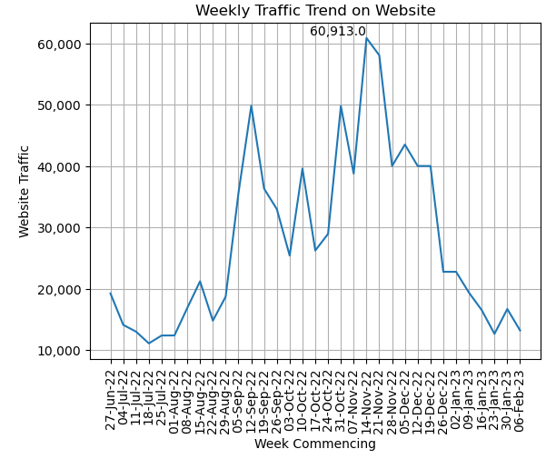
Explanatory Data Analysis
Website Traffic Trend
There are peaks and dips in website traffic during certain months of the year, with traffic generally increasing towards the end of the year and decreasing at the beginning of the year.
Upward trend in website traffic suggests that the website is likely gaining more visibility or becoming more popular over time. However, there are also some fluctuations in traffic from week to week, and the pattern is not entirely consistent.
This seasonal pattern could be driven by a number of factors, such as holiday shopping, changes in consumer behavior or preferences, or weather patterns.
While higher traffic can increase the potential for revenue or conversions, the actual conversion rate (the percentage of visitors who take a desired action, such as making a purchase)

Slide 8
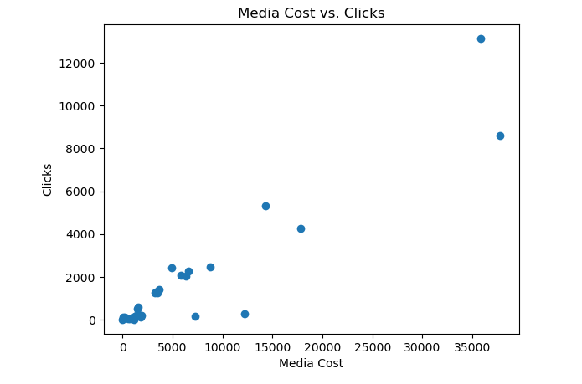
Explanatory Data Analysis
Correlation between media cost and the number of clicks
A positive correlation between media cost and the number of clicks received. This suggests that when more money is spent on media, there is an increase in the number of clicks that the website receives.
This trend could be a result of a number of factors, such as more visibility for the website due to increased ad spend, better ad targeting leading to more clicks, or a combination of both.

Slide 9
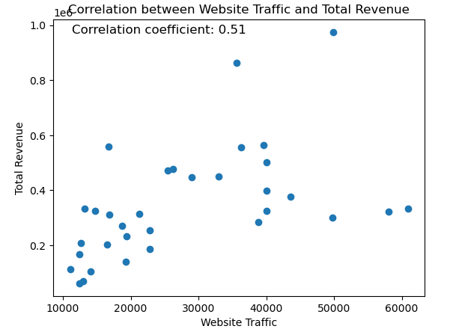
Explanatory Data Analysis
Correlation coefficient between website traffic and total revenue
A correlation coefficient of 0.5118 between website traffic and total revenue indicates a positive correlation between the two variables, but the strength of the correlation is moderate, not strong.
A coefficient of 1 would indicate a perfect positive correlation, while a coefficient of 0 would indicate no correlation, and a coefficient of -1 would indicate a perfect negative correlation. In this case, a coefficient of 0.5118 indicates that as website traffic increases, total revenue is likely to increase as well, but the relationship between the two variables is not extremely strong.
It can be assumed that the relationship between website traffic and total revenue is influenced by other factors such as the quality of the traffic, the user experience on the website, the pricing of products or services, the marketing strategies used, and so on.

Slide 10
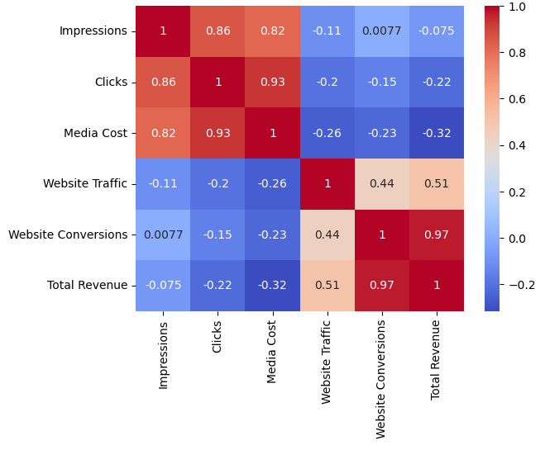
Explanatory Data Analysis
Visual representation of the correlation matrix
Each square in the heatmap represents the correlation between two variables, with color indicating the strength and direction of the correlation.
There is a moderate positive correlation between total revenue and website traffic, as well as a moderate positive correlation between total revenue and the number of clicks.
Also, a moderate positive correlation between website traffic and the number of clicks.

Slide 11
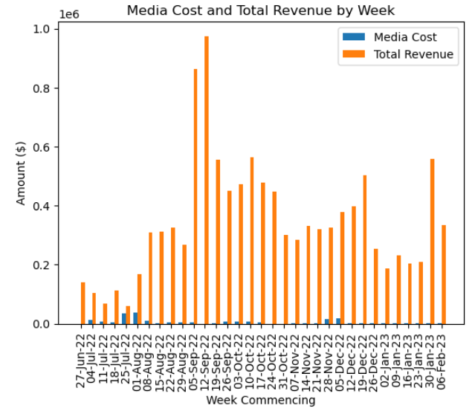
Overview
Bar chart shows the orange bar (total revenue) is much higher than the blue bar (media cost), it means that the company made a higher total revenue than the cost of media for that particular week. This can be a positive sign for the company, as it indicates that the advertising strategy was effective in generating revenue.

Slide 12


Explanatory Data Analysis
KEY FINDINGS
- Total Revenue of $11,485,888.74 generated in 33 weeks
- Week with the highest conversion rate was on 30-Jan-23 with Conversion rate of 1.62%. There are few potential factors that could have contributed such as marketing promotions or discounts, Increased website optimization or Seasonal trends.
- Average cost per click (CPC) is $3.74 (Media Cost / Clicks). The number of clicks that a website receives can be influenced by the CPC, as higher CPCs can result in more ads being displayed and more clicks being generated. The number of clicks can in turn influence the revenue generated, as more clicks can lead to more website traffic and ultimately more sales.
- The week commencing 25-Jul-22 had the highest number of impressions, with a total of 3,788,966.84 impressions. This is significantly higher than the impressions in other weeks, which range from 10 to 1,934,297. It is possible that the business invested in additional advertising channels or increased their ad spend on existing channels during this time. It is also possible that there was a seasonal event or promotion that led to increased traffic and impressions during this week.

Slide 13
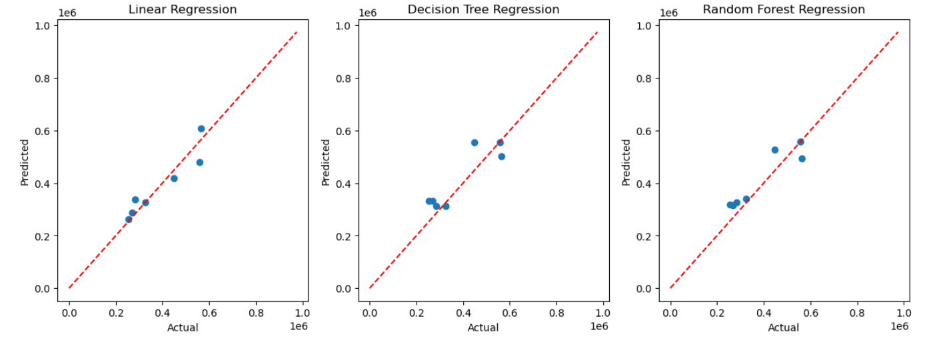
Modeling Comparison
In the scatter plot for the Linear Regression model, the points are clustered closely around the red line which represents the ideal scenario where the predicted values match the actual values perfectly. This indicates that the Linear Regression model is able to predict the revenue values with good accuracy.In contrast, the scatter plots for the Decision Tree and Random Forest models are more scattered, indicating that these models may not be as accurate in their predictions as the Linear Regression model.

Slide 14
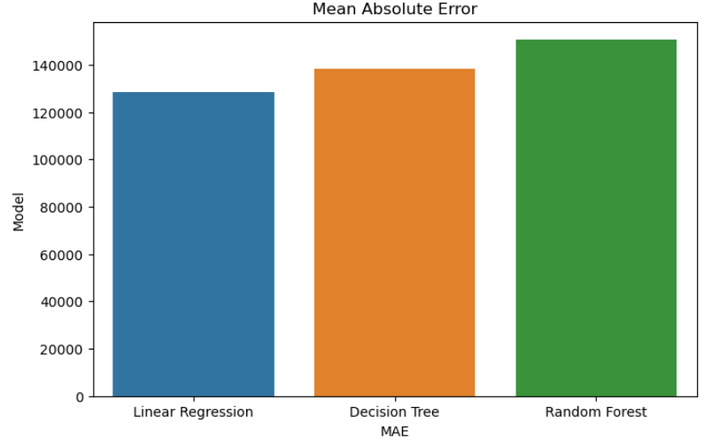
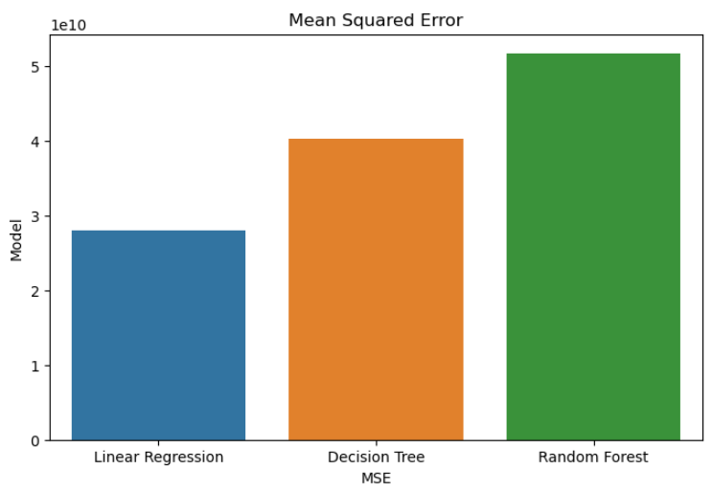
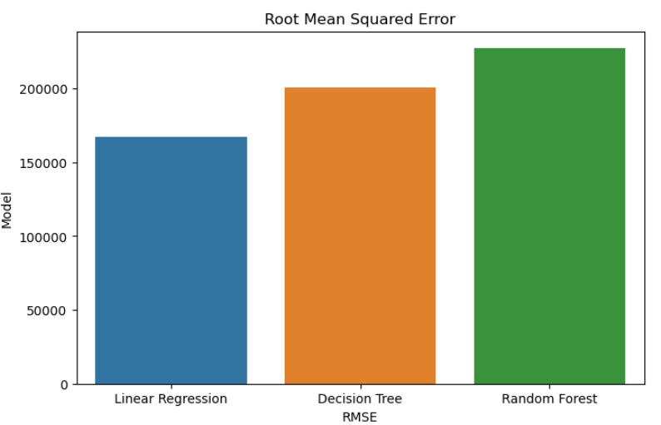
Evaluation Metrics
In reference to the evaluation metrics, Linear Regression appears to have the best performance, with the lowest values for Mean Absolute Error (MAE), Mean Squared Error (MSE), and Root Mean Squared Error (RMSE). We can, therefore, use these models to predict revenue with a certain degree of accuracy, allowing for better financial planning and decision-making. Decision Tree Regression also performs well, but not as well as Linear Regression. Random Forest Regression has the highest values for all three metrics, indicating poorer performance.
Overall, the evaluation metrics give the business an idea of which models are the most effective and can be used to guide decision-making and resource allocation.

Slide 15



Summary
Predicted number of impressions, clicks, and media cost for $10 million revenue
PREDICTED IMPRESSIONS
PREDICTED CLICKS
PREDICTED MEDIA COST
251,804
256,576
$236,842

Slide 16

Insights and Recommendations
MEDIA COST AND WEBSITE TRAFFIC ARE THE TWO MOST IMPORTANT FACTORS IN DETERMINING THE NUMBER OF IMPRESSIONS AND CLICKS.
THE CONVERSION RATE IS RELATIVELY LOW ACROSS ALL WEEKS, RANGING FROM 0.26% TO 1.62%.
THE COMPANY SHOULD INVESTIGATE WAYS TO IMPROVE ITS WEBSITE CONVERSION RATE, SUCH AS IMPROVING THE USER EXPERIENCE OR OFFERING PROMOTIONS.
THEREFORE, THE COMPANY SHOULD FOCUS ON INCREASING ITS MEDIA SPEND AND DRIVING MORE TRAFFIC TO ITS WEBSITE IN ORDER TO INCREASE ITS IMPRESSIONS AND CLICKS.
THE WEBSITE TRAFFIC AND WEBSITE CONVERSION VARIABLES HAVE A SIGNIFICANT POSITIVE EFFECT ON TOTAL REVENUE, WHILE THE CONVERSION RATE VARIABLE HAS A SIGNIFICANT NEGATIVE EFFECT. THIS SUGGESTS THAT THE COMPANY SHOULD FOCUS ON INCREASING TRAFFIC AND CONVERSION, RATHER THAN JUST INCREASING THE CONVERSION RATE.
LINEAR REGRESSION IS THE BEST-PERFORMING MODEL, FOLLOWED BY DECISION TREE REGRESSION. THE RANDOM FOREST MODEL DID NOT PERFORM AS WELL,
FINALLY, THE COMPANY SHOULD CONTINUE TO MONITOR AND ANALYZE ITS DATA IN ORDER TO IDENTIFY TRENDS AND OPPORTUNITIES FOR IMPROVEMENT.
SO THE COMPANY SHOULD USE THE LINEAR OR DECISION TREE REGRESSION MODELS FOR FUTURE PREDICTIONS.
BY USING DATA-DRIVEN INSIGHTS, THE COMPANY CAN MAKE INFORMED DECISIONS THAT LEAD TO BETTER PERFORMANCE AND INCREASED REVENUE.

Slide 17
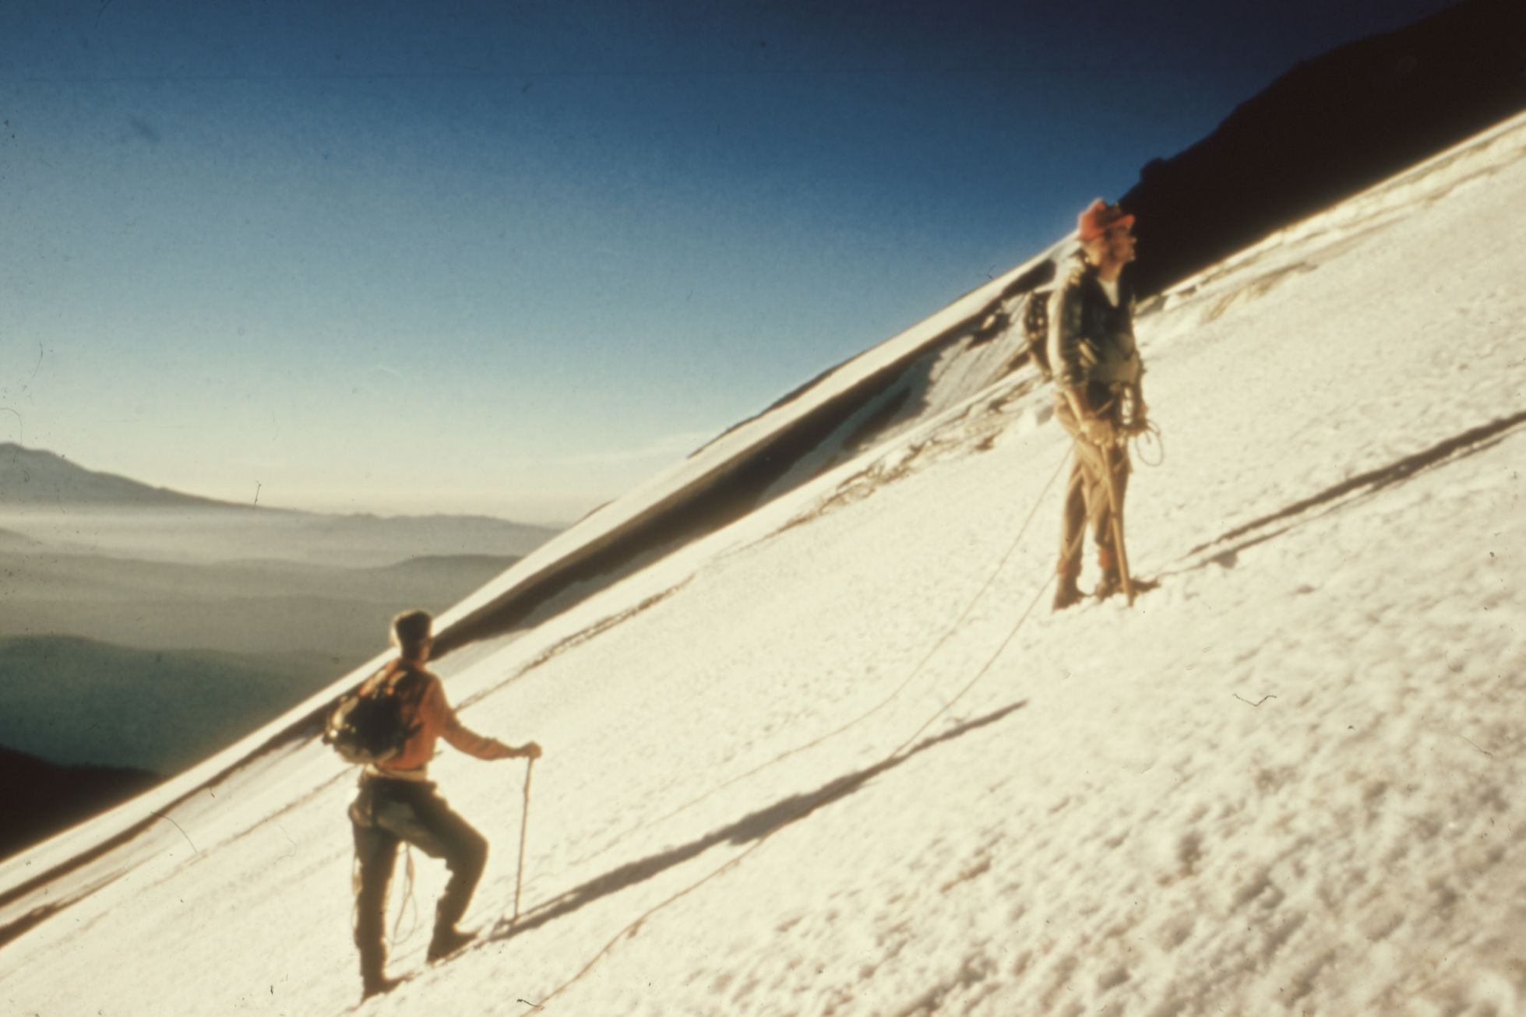


Action Plan
INCREASE INVESTMENT IN DIGITAL MEDIA: THE ANALYSIS SHOWED THAT MEDIA SPEND IS A SIGNIFICANT PREDICTOR OF WEBSITE TRAFFIC, CONVERSIONS, AND REVENUE. THEREFORE, THE COMPANY MAY WANT TO CONSIDER INCREASING THEIR INVESTMENT IN DIGITAL MEDIA TO IMPROVE THEIR ONLINE VISIBILITY AND ATTRACT MORE POTENTIAL CUSTOMERS.
OPTIMIZE THE WEBSITE: THE CONVERSION RATE WAS FOUND TO BE POSITIVELY CORRELATED WITH WEBSITE TRAFFIC, INDICATING THAT OPTIMIZING THE WEBSITE FOR USER EXPERIENCE AND EASE OF USE CAN LEAD TO HIGHER CONVERSION RATES. THE COMPANY COULD PERFORM A/B TESTING AND USER RESEARCH TO IDENTIFY AREAS FOR IMPROVEMENT AND MAKE NECESSARY CHANGES.
FOCUS ON HIGH-TRAFFIC PERIODS: THE ANALYSIS SHOWED THAT WEBSITE TRAFFIC AND REVENUE TEND TO INCREASE DURING CERTAIN PERIODS, SUCH AS THE HOLIDAY SEASON. THE COMPANY COULD PLAN AND EXECUTE TARGETED CAMPAIGNS DURING THESE PERIODS TO TAKE ADVANTAGE OF THE INCREASED TRAFFIC AND POTENTIAL REVENUE.
MONITOR AND ANALYZE DATA REGULARLY: THE COMPANY SHOULD CONTINUE TO MONITOR AND ANALYZE THEIR DATA REGULARLY TO IDENTIFY TRENDS AND PATTERNS, ADJUST STRATEGIES AS NECESSARY, AND STAY AHEAD OF THE COMPETITION. THIS CAN HELP THE COMPANY MAKE INFORMED DECISIONS AND MAXIMIZE THEIR RETURN ON INVESTMENT.

Slide 18
Thank you

